Slide 1
Chapter 16 Greedy Algorithms
Chi-Yeh Chen
陳奇業
成功大學資訊工程學系

Slide 2
Introduction
Similar to dynamic programming.
Use for optimization problems.
Idea:
When we have a choice to make, make the one that looks best right now. Make a locally optimal choice in hope of getting a globally optimal solution
Greedy algorithms do not always yield optimal solutions, but for many problems they do.

Slide 3
Activity selection problem

Slide 4
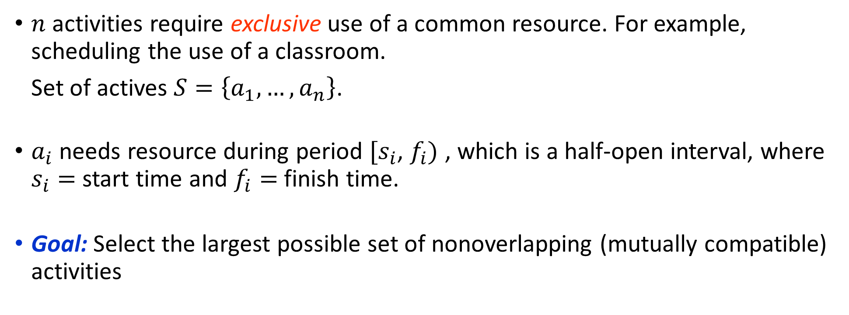
Activity selection
$n$ activities require exclusive use of a common resource. For example, scheduling the use of a classroom.
Set of actives $S=\left\{a_{1},…,a_{n}\right\}$.
$a_{i}$ needs resource during period $[s_{i}$, $f_{i})$ , which is a half-open interval, where $s_{i}=$ start time and $f_{i}=$ finish time.
Goal: Select the largest possible set of nonoverlapping (mutually compatible) activities

Slide 5
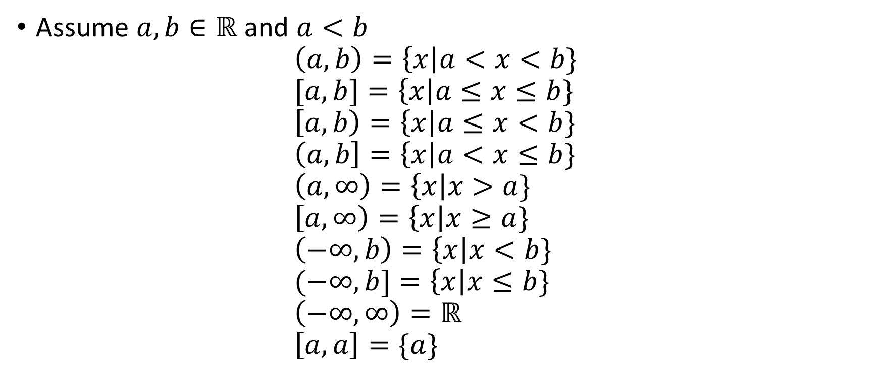
Assume $a,b∈ℝ$ and $a<b$ $\left(a,b\right)=\left\{x\right|a<x<b\}$ $[a,b]=\left\{x\right|a≤x≤b\}$ $\left[a,b\right)=\left\{x\right|a≤x<b\}$ $\left(a,b\right]=\left\{x\right|a<x≤b\}$ $\left(a,∞\right)=\left\{x\right|x>a\}$ $\left[a,∞\right)=\left\{x\right|x≥a\}$ $\left(−∞,b\right)=\left\{x\right|x<b\}$ $(−∞,b]=\left\{x\right|x≤b\}$ $\left(−∞,∞\right)=ℝ$ $\left[a,a\right]=\{a\}$

Slide 6

Example： $S$ sorted by finish time:
Maximum-size mutually compatible set:$\left[a_{1,}a_{3},a_{6},a_{8}\right]$.
Not unique: also $\left[a_{2,}a_{5},a_{7},a_{9}\right]$
i | 1 | 2 | 3 | 4 | 5 | 6 | 7 | 8 | 9
s_{i} | 1 | 2 | 4 | 1 | 5 | 8 | 9 | 11 | 13
f_{i} | 3 | 5 | 7 | 8 | 9 | 10 | 11 | 14 | 16

Slide 7
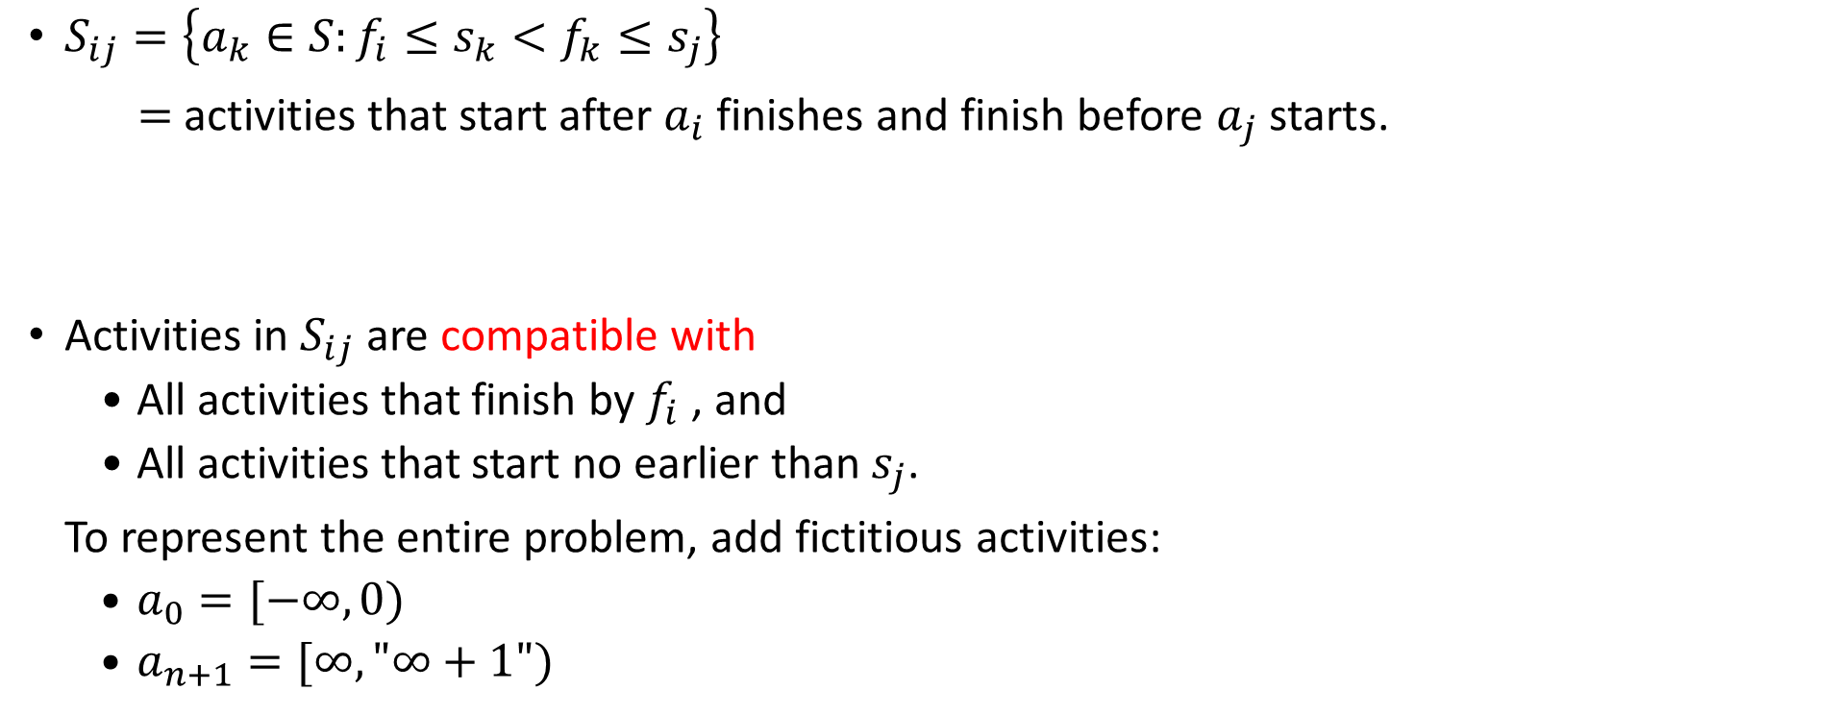
Optimal substructure of activity selection
$S_{ij}=\left\{a_{k}∈S:f_{i}≤s_{k}<f_{k}≤s_{j}\right\}$
$=$ activities that start after $a_{i}$ finishes and finish before $a_{j}$ starts.
Activities in $S_{ij}$ are compatible with
All activities that finish by $f_{i}$, and
All activities that start no earlier than $s_{j}$.
To represent the entire problem, add fictitious activities:
$a_{0}=[−∞,0)$
$a_{n+1}=[∞,"∞+1")$

Slide 8


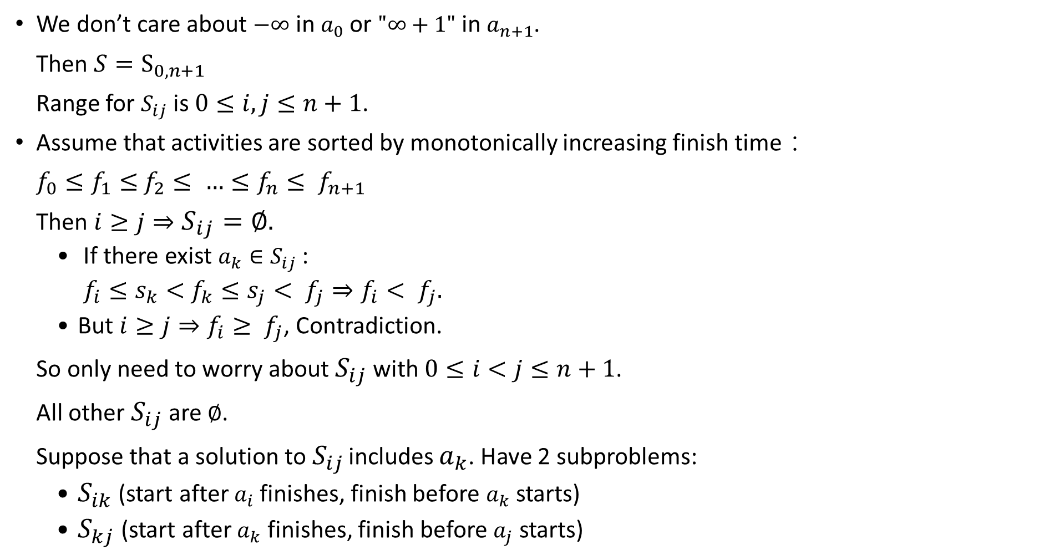


We don’t care about $−∞$ in $a_{0}$or $"∞+1"$ in $a_{n+1}$.
Then $S=S_{0,n+1}$
Range for $S_{ij}$ is $0≤i,j≤n+1$.
Assume that activities are sorted by monotonically increasing finish time：
$f_{0}≤f_{1}≤$ $f_{2}≤ {…≤f}_{n}≤ f_{n+1}$
Then $i≥j⇒S_{ij}=∅.$
If there exist $a_{k}{∈S}_{ij}$:
$f_{i}≤s_{k}<$ $f_{k}≤s_{j}< f_{j}⇒f_{i}< f_{j}.$
But $i≥j⇒f_{i}≥ f_{j}$, Contradiction.
So only need to worry about $S_{ij}$ with $0≤i<j≤n+1$.
All other $S_{ij}$ are $∅$.
Suppose that a solution to $S_{ij}$ includes $a_{k}$. Have 2 subproblems:
$S_{ik}$(start after $a_{i}$finishes, finish before $a_{k}$ starts)
$S_{kj}$(start after $a_{k}$ finishes, finish before $a_{j}$ starts)

Slide 9
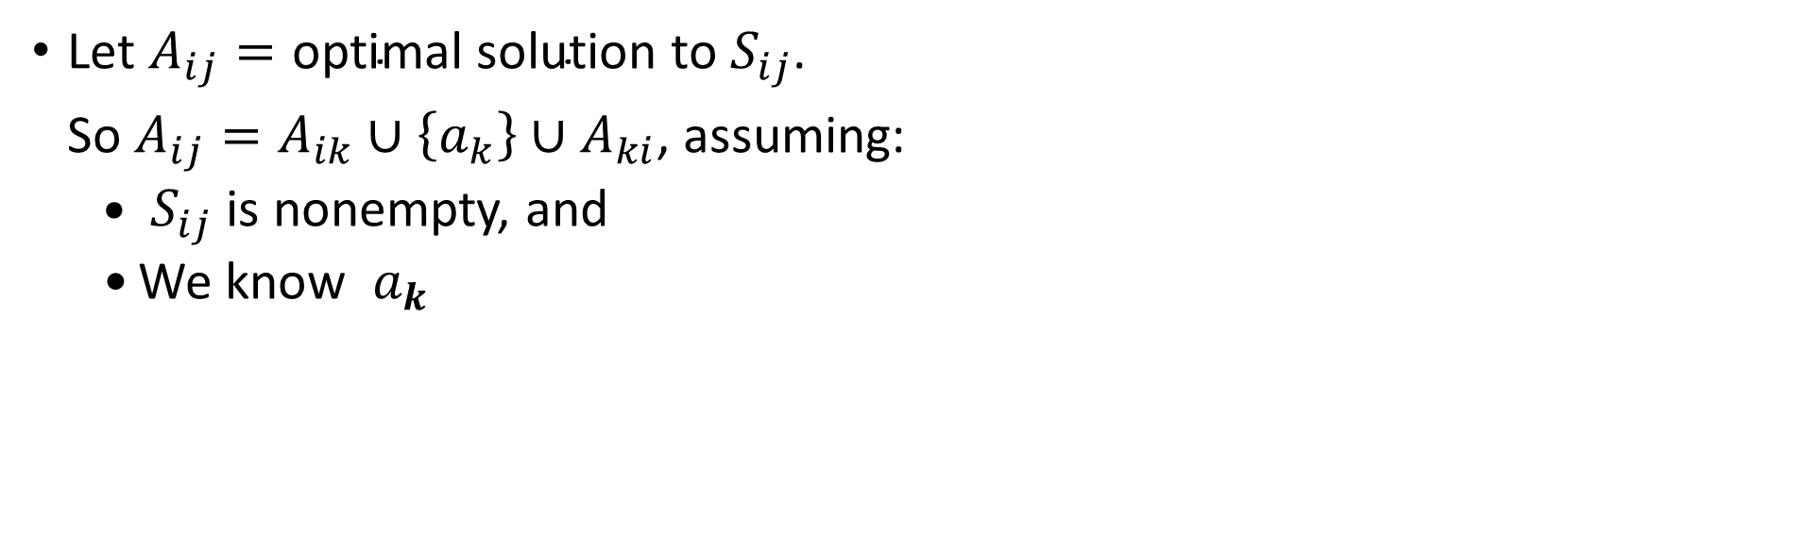
Let $A_{ij}=\text{optimal} \text{solution} \text{to}{ S}_{ij}$.
So $A_{ij}=A_{ik}∪\left\{a_{k}\right\}∪A_{ki}$, assuming:
${ S}_{ij}$ is nonempty, and
We know ${ a}_{k}$

Slide 10
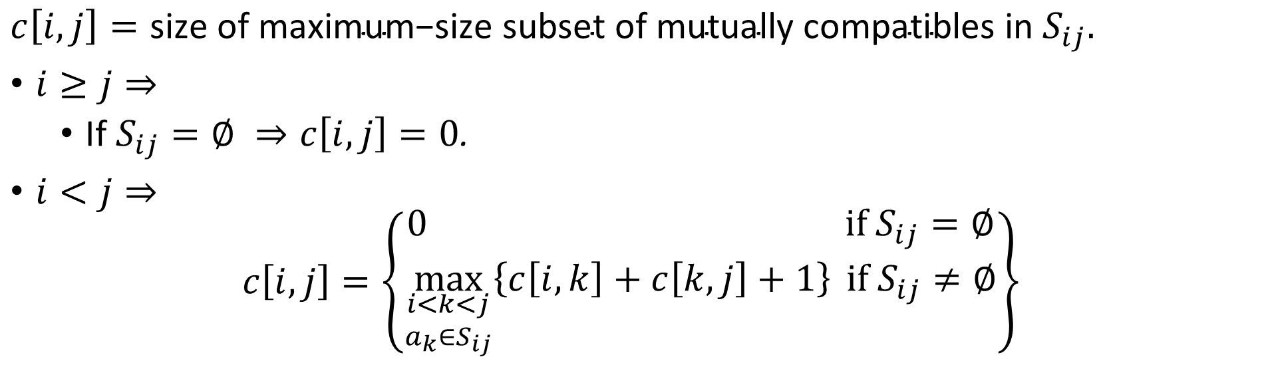
Recursive solution to activity selection
$c\left[i,j\right]=\text{size} \text{of} \text{maximum}\text{−}\text{size} \text{subset} \text{of} \text{mutually} \text{compatibles} \text{in}$ $S_{ij}.$
$i≥j⇒$
If $S_{ij}=∅ ⇒c\left[i,j\right]=0$.
$i<j⇒$
$$c\left[i,j\right]=\left\{\begin{matrix}0 if S_{ij}=∅ \\ \max_{\begin{aligned}i<k<j \\ a_{k}∈S_{ij}\end{aligned}}\left\{c\left[i,k\right]+c\left[k,j\right]+1\right\} if S_{ij}≠∅\end{matrix}\right\}$$

Slide 11
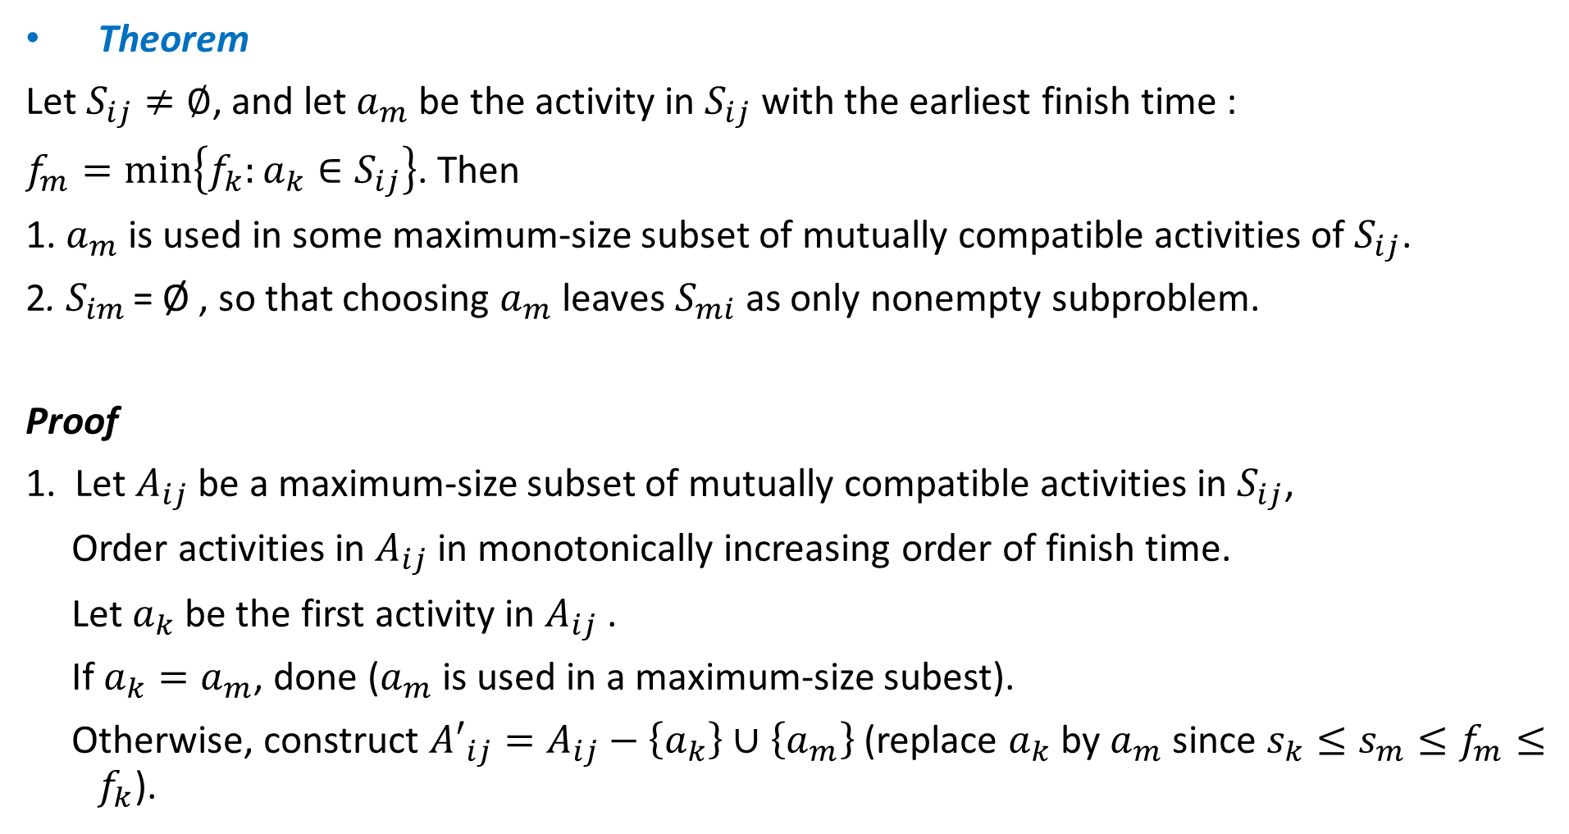
Theorem
Let $S_{ij}≠∅$, and let $a_{m}$ be the activity in $S_{ij}$ with the earliest finish time :
$f_{m}=min\left\{f_{k}:a_{k}∈S_{ij}\right\}$. Then
1. $a_{m}$ is used in some maximum-size subset of mutually compatible activities of $S_{ij}$.
2. $S_{im}$ = Ø , so that choosing $a_{m}$ leaves $S_{mi}$as only nonempty subproblem.
Proof
1. Let $A_{ij}$ be a maximum-size subset of mutually compatible activities in $S_{ij}$,
Order activities in $A_{ij}$ in monotonically increasing order of finish time.
Let $a_{k}$ be the first activity in $A_{ij}$ .
If $a_{k}=a_{m}$, done ($a_{m}$ is used in a maximum-size subest).
Otherwise, construct ${A′}_{ij}=A_{ij}−\left\{a_{k}\right\}∪\left\{a_{m}\right\}$ (replace $a_{k}$ by $a_{m}$ since $s_{k}≤s_{m}≤f_{m}≤f_{k}$).

Slide 12
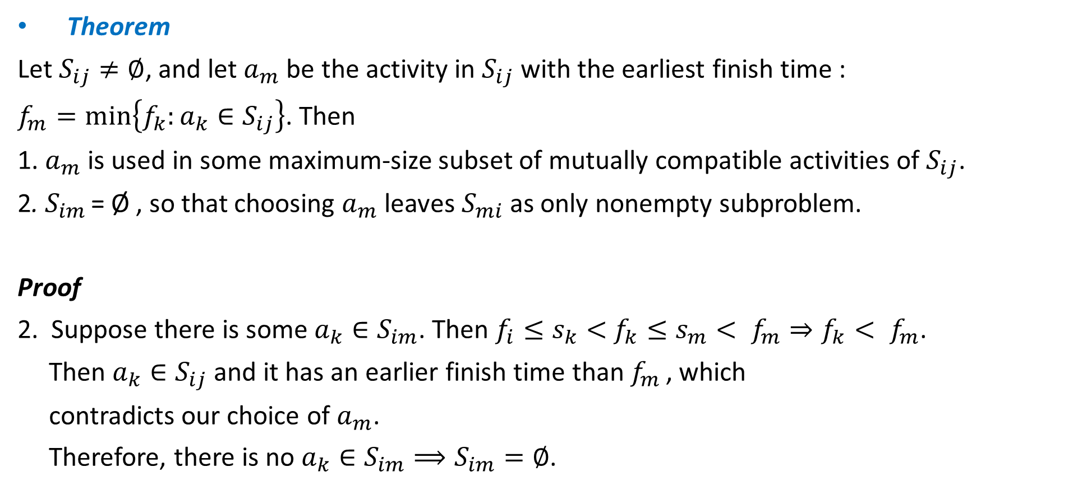
Theorem
Let $S_{ij}≠∅$, and let $a_{m}$ be the activity in $S_{ij}$ with the earliest finish time :
$f_{m}=min\left\{f_{k}:a_{k}∈S_{ij}\right\}$. Then
1. $a_{m}$ is used in some maximum-size subset of mutually compatible activities of $S_{ij}$.
2. $S_{im}$ = Ø , so that choosing $a_{m}$ leaves $S_{mi}$as only nonempty subproblem.
Proof
2. Suppose there is some $a_{k}∈S_{im}$. Then $f_{i}≤s_{k}<$ $f_{k}≤s_{m}< f_{m}⇒f_{k}< f_{m}$.
Then $a_{k}∈S_{ij}$and it has an earlier finish time than $f_{m}$ , which
contradicts our choice of $a_{m}$.
Therefore, there is no $a_{k}∈S_{im}⟹S_{im}=∅$.

Slide 13
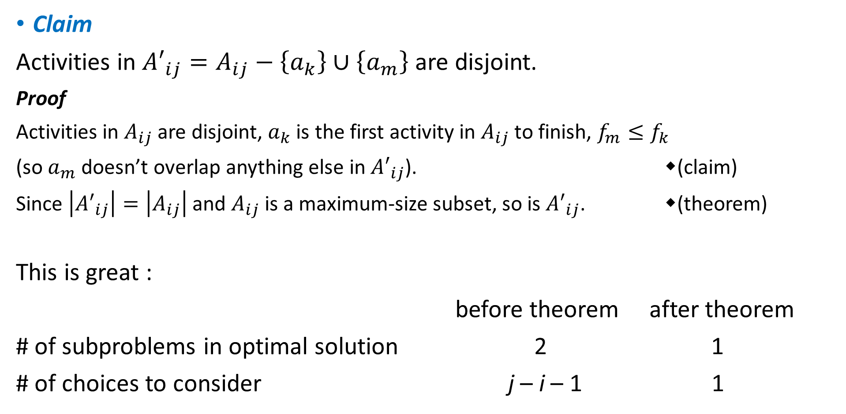
Claim
Activities in ${A′}_{ij}=A_{ij}−\left\{a_{k}\right\}∪\left\{a_{m}\right\}$ are disjoint.
Proof
Activities in $A_{ij}$are disjoint, $a_{k}$ is the first activity in $A_{ij}$ to finish, $f_{m}≤f_{k}$
(so $a_{m}$ doesn’t overlap anything else in ${A′}_{ij}$). (claim)
Since $\left|{A′}_{ij}\right|=\left|A_{ij}\right|$ and $A_{ij}$ is a maximum-size subset, so is ${A′}_{ij}$. (theorem)
This is great :
before theorem after theorem
# of subproblems in optimal solution 2 1
# of choices to consider j – i – 1 1

Slide 14
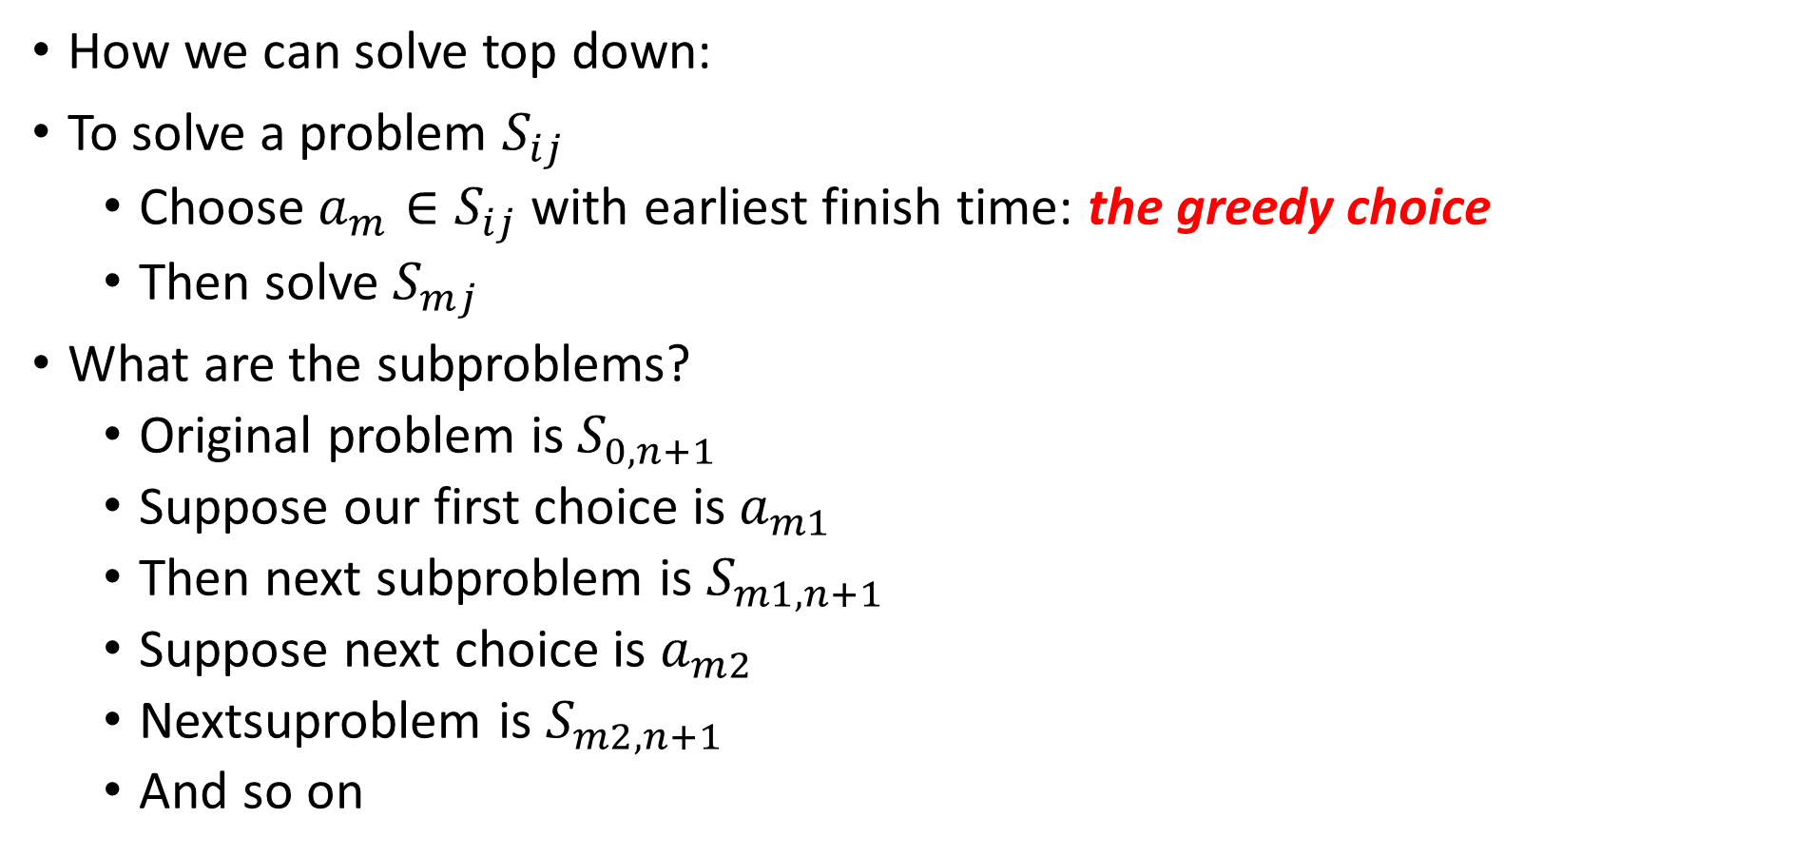
How we can solve top down:
To solve a problem $S_{ij}$
Choose $a_{m}∈S_{ij}$with earliest finish time: the greedy choice
Then solve $S_{mj}$
What are the subproblems?
Original problem is $S_{0,n+1}$
Suppose our first choice is $a_{m1}$
Then next subproblem is $S_{m1,n+1}$
Suppose next choice is $a_{m2}$
Nextsuproblem is $S_{m2,n+1}$
And so on

Slide 15

Easy recursive algorithm:
Assumes activities already sorted by monotonically increasing finish time.
(If not, then sort in $O\left(n\lg{n}\right)$ time)
Return an optimal solution for $S_{i, n+1}$:
Initial call: REC-ACTIVITY-SELECTOR($s$, $f$, $0$, $n$)
Time: $Θ\left(n\right)$ ― each activity examined exactly once.

Slide 17

Can make this iterative. It’s already almost tail recursive.
Time: $Θ\left(n\right)$.

Slide 18
Elements of the greedy strategy

Slide 19
Greedy Strategy (typical streamline steps):
Cast the optimization problem as one in which we make a choice and are left with one subproblem to solve.
Prove that there’s always an optimal solution that make the greedy choice, so that the greedy choice is always safe. (greedy-choice property)
Show that greedy choice and optimal solution to subprblem ⇒ optimal solution to the problem. (optimal substructure)
No general way to tell if a greedy algorithm is optimal, but two key ingredients are
greedy-choice property and
optimal substructure.

Slide 20
Greedy-choice property
A globally optimal solution can be arrived at by making a locally optimal (greedy) choice. i.e. the greedy-choice is the optimal choice.
Dynamic programming
Make a choice at each step.
Choice depends on knowing optimal solutions to subproblems.
Solve subproblems first.
Solve bottom-up.
Greedy
Make a choice at each step.
Make the choice before solving the subproblems
Solve top-down.

Slide 21
Optimal substructure
Just show that optimal solution to subproblem and greedy choice ⇒ optimal solution to problem.
Greedy vs. dynamic programming
The knapsack problem is a good example of the difference.

Slide 22
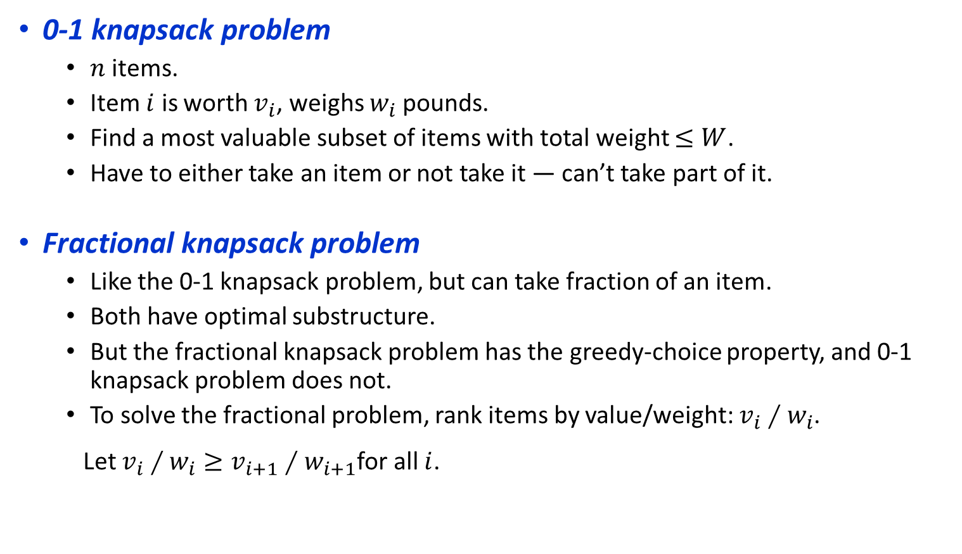
0-1 knapsack problem
$n$ items.
Item $i$ is worth $v_{i}$, weighs $w_{i}$pounds.
Find a most valuable subset of items with total weight $≤W$.
Have to either take an item or not take it ― can’t take part of it.
Fractional knapsack problem
Like the 0-1 knapsack problem, but can take fraction of an item.
Both have optimal substructure.
But the fractional knapsack problem has the greedy-choice property, and 0-1 knapsack problem does not.
To solve the fractional problem, rank items by value/weight: $v_{i}∕w_{i}$.
Let $v_{i}∕w_{i}≥v_{i+1}∕w_{i+1}$for all $i$.

Slide 23

Time: $O\left(n\lg{n}\right)$ to sort, $O\left(n\right)$ thereafter.

Slide 24
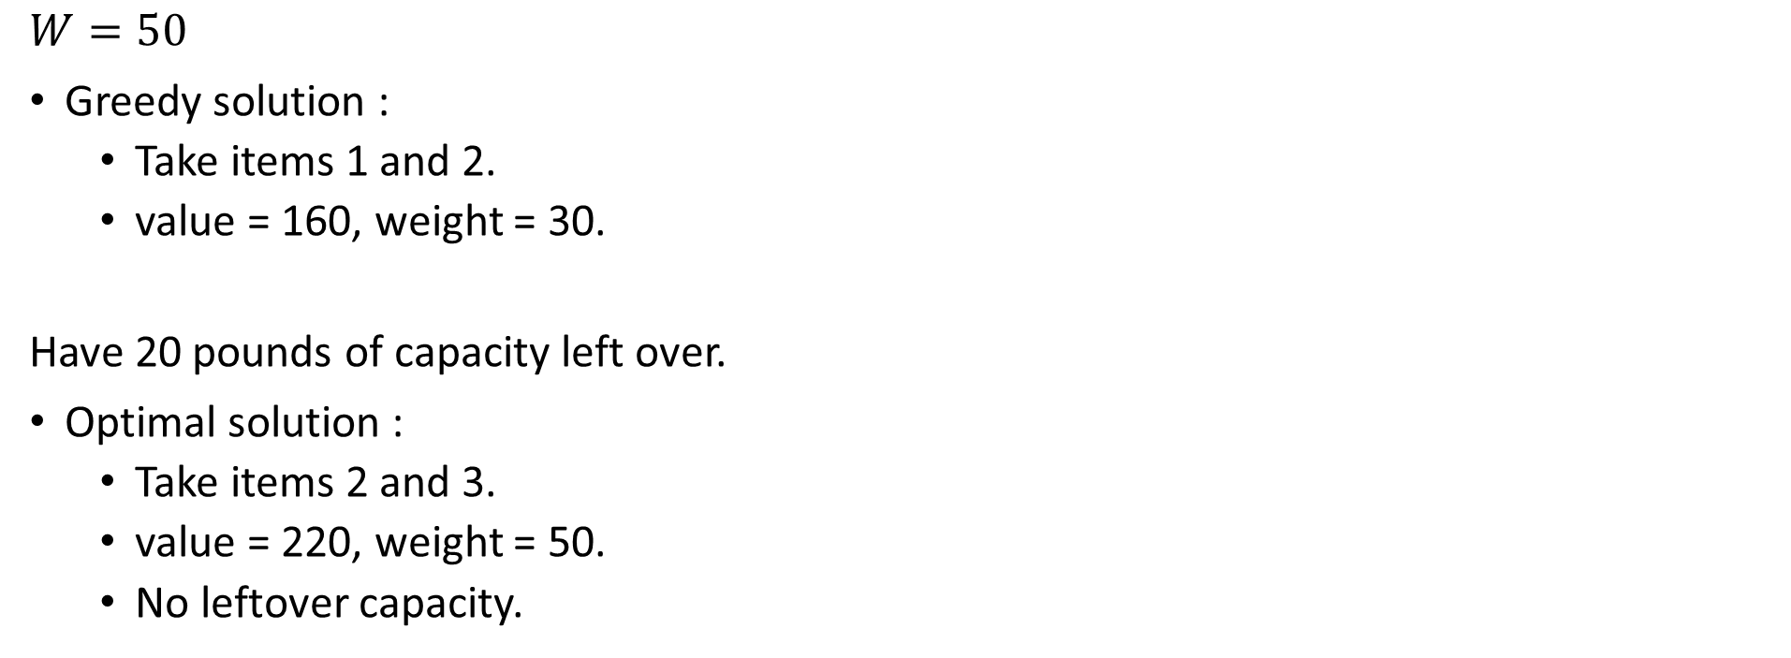
Greedy don’t work for 0-1 knapsack problem
$$W=50$$
Greedy solution :
Take items 1 and 2.
value = 160, weight = 30.
Have 20 pounds of capacity left over.
Optimal solution :
Take items 2 and 3.
value = 220, weight = 50.
No leftover capacity.
i | 1 | 2 | 3
v_{i} / w_{i} | 6 | 5 | 4

Slide 25
Huffman codes

Slide 26
Huffman codes
Prefix code: no codeword is also a prefix of some other codeword.
 | a | b | c | d | e | f
Frequency (in hundred) | 45 | 13 | 12 | 16 | 9 | 5
Fixed length codeword | 000 | 001 | 010 | 011 | 100 | 101
Variable length codeword | 0 | 101 | 100 | 111 | 1101 | 1100

Slide 27
Can be shown that the optimal data compression achievable by a character code can always be achieved with prefix codes.
Simple encoding and decoding.
An optimal code for a file is always represented by a binary tree.

Slide 28

Constructing a Huffman code
Complexity: $O\left(n\lg{n}\right)$

Slide 29
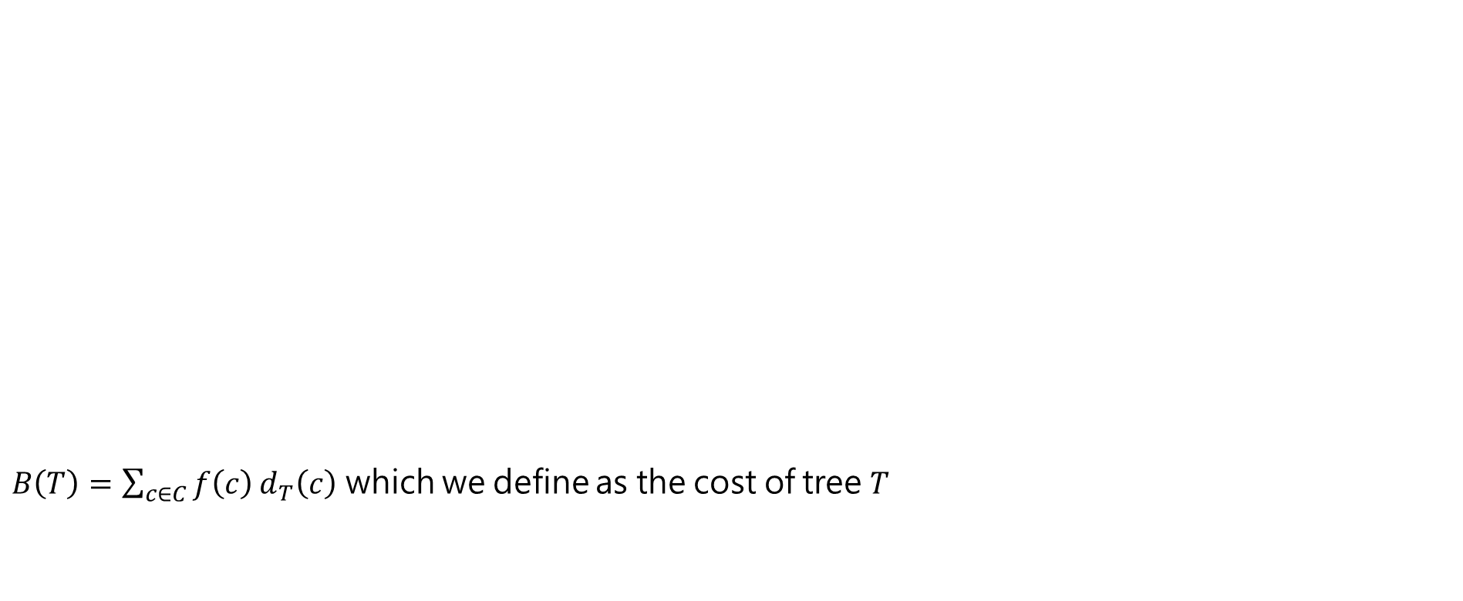
Tree correspond to the coding schemes
$B\left(T\right)=\sum_{c∈C}{f\left(c\right)}d_{T}\left(c\right)$ which we define as the cost of tree $T$

Slide 30
The steps of Huffman’s algorithm

Slide 31
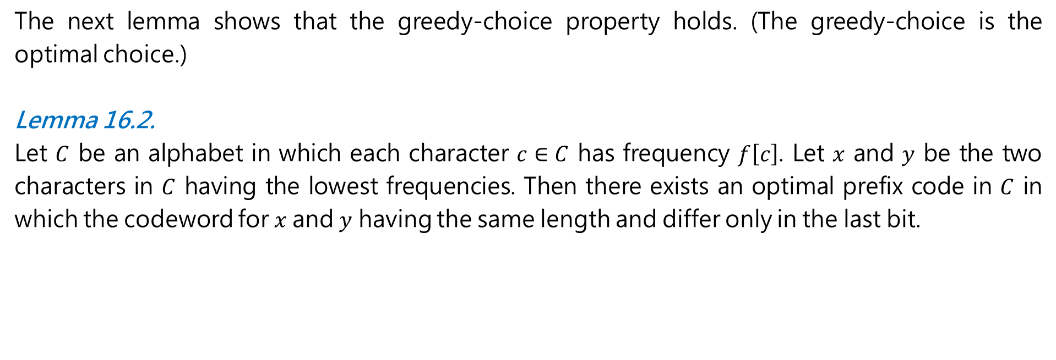
Correction of Huffman’s algorithm
The next lemma shows that the greedy-choice property holds. (The greedy-choice is the optimal choice.)
Lemma 16.2.
Let $C$ be an alphabet in which each character $c∈C$ has frequency $f\left[c\right]$. Let $x$ and $y$ be the two characters in $C$ having the lowest frequencies. Then there exists an optimal prefix code in $C$ in which the codeword for $x$and $y$ having the same length and differ only in the last bit.

Slide 32
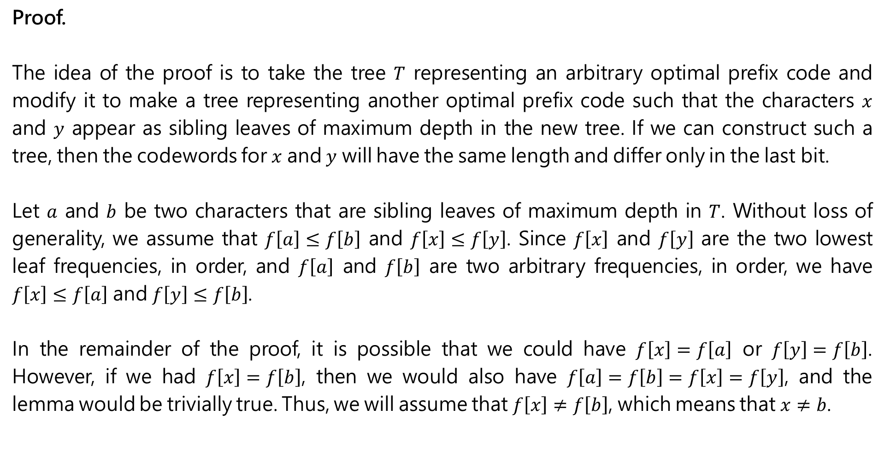
Proof.
The idea of the proof is to take the tree $T$ representing an arbitrary optimal prefix code and modify it to make a tree representing another optimal prefix code such that the characters $x$ and $y$ appear as sibling leaves of maximum depth in the new tree. If we can construct such a tree, then the codewords for $x$ and $y$ will have the same length and differ only in the last bit.
Let $a$ and $b$ be two characters that are sibling leaves of maximum depth in $T$. Without loss of generality, we assume that $f\left[a\right]≤f\left[b\right]$ and $f\left[x\right]≤f\left[y\right]$. Since $f\left[x\right]$ and $f\left[y\right]$ are the two lowest leaf frequencies, in order, and $f\left[a\right]$ and $f\left[b\right]$ are two arbitrary frequencies, in order, we have $f\left[x\right]≤f\left[a\right]$ and $f\left[y\right]≤f\left[b\right]$.
In the remainder of the proof, it is possible that we could have $f\left[x\right]=f\left[a\right]$ or $f\left[y\right]=f\left[b\right]$. However, if we had $f\left[x\right]=f\left[b\right]$, then we would also have $f\left[a\right]=f\left[b\right]=f\left[x\right]=f\left[y\right]$, and the lemma would be trivially true. Thus, we will assume that $f\left[x\right]≠f\left[b\right]$, which means that $x≠b$.

Slide 33
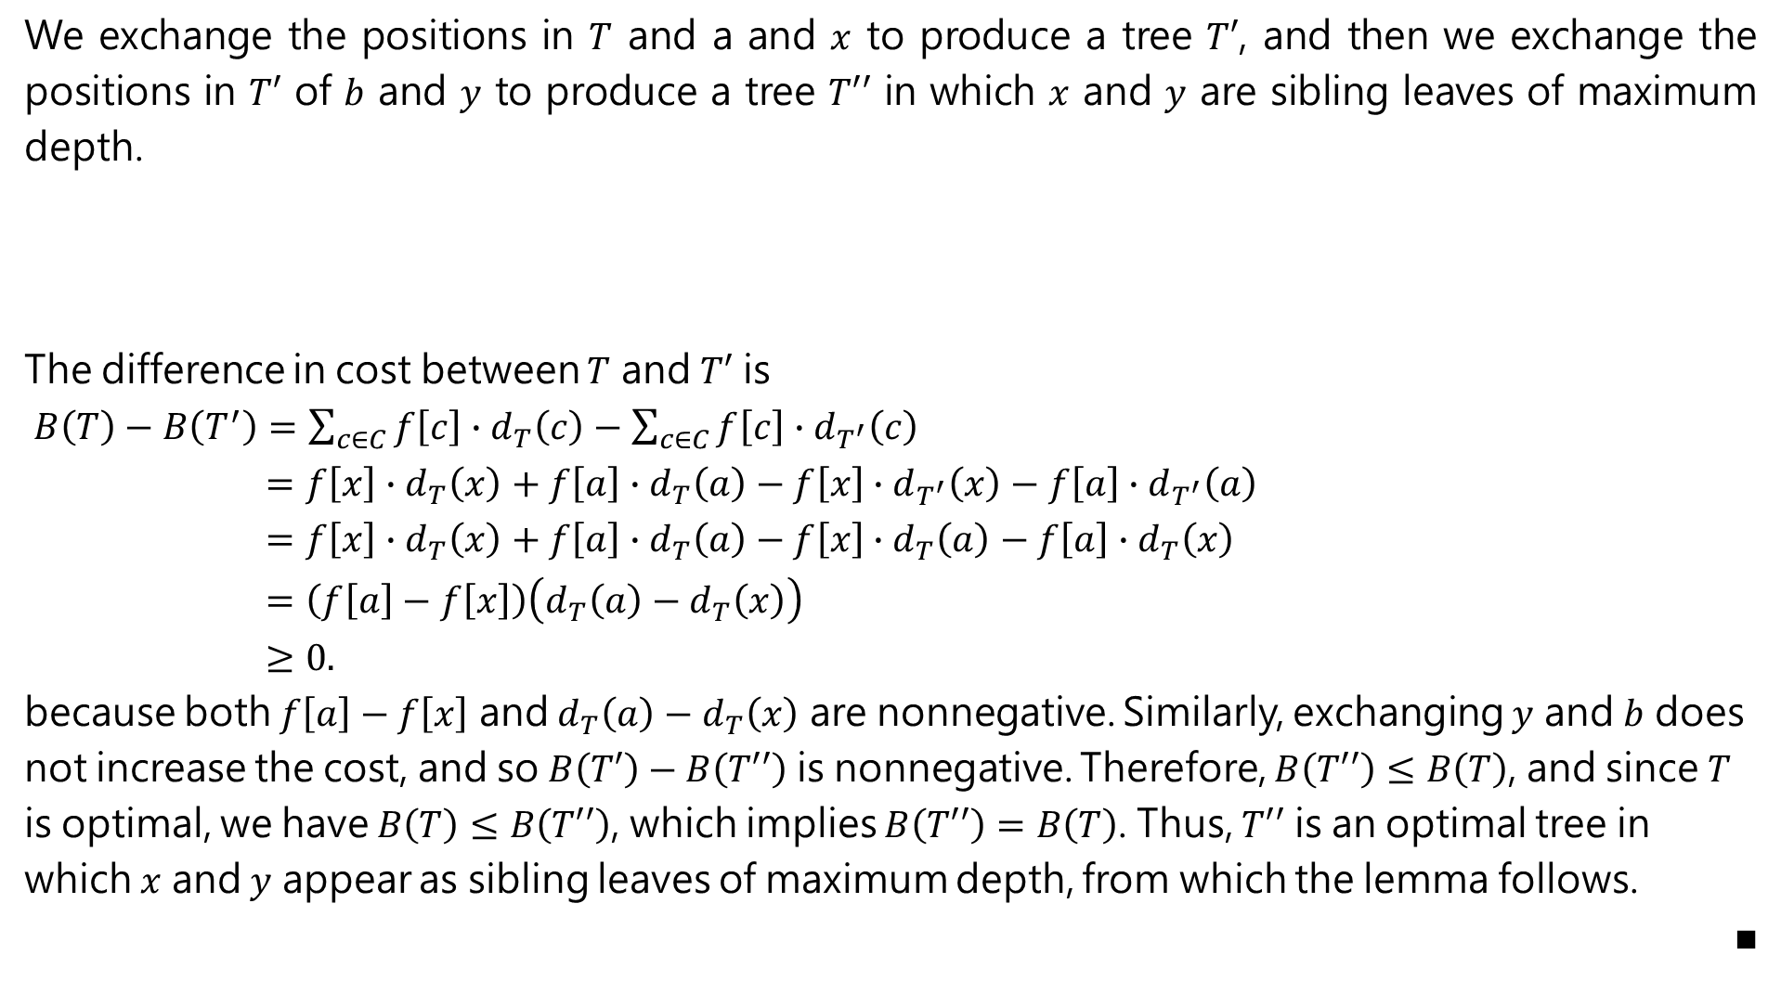
We exchange the positions in $T$ and a and $x$ to produce a tree $T′$, and then we exchange the positions in $T′$ of $b$ and $y$ to produce a tree $T′′$ in which $x$ and $y$ are sibling leaves of maximum depth.
The difference in cost between $T$ and $T′$ is
$B\left(T\right)−B\left(T^{′}\right)=\sum_{c∈C}{f\left[c\right]∙d_{T}\left(c\right)}−\sum_{c∈C}{f\left[c\right]∙d_{T^{′}}\left(c\right)}$
$=f\left[x\right]∙d_{T}\left(x\right)+f\left[a\right]∙d_{T}\left(a\right)−f\left[x\right]∙d_{T^{′}}\left(x\right)−f\left[a\right]∙d_{T^{′}}\left(a\right)$
$=f\left[x\right]∙d_{T}\left(x\right)+f\left[a\right]∙d_{T}\left(a\right)−f\left[x\right]∙d_{T}\left(a\right)−f\left[a\right]∙d_{T}\left(x\right)$
$=\left(f\left[a\right]−f\left[x\right]\right)\left(d_{T}\left(a\right)−d_{T}\left(x\right)\right)$
$≥0.$
because both $f\left[a\right]−f\left[x\right]$ and $d_{T}\left(a\right)−d_{T}\left(x\right)$ are nonnegative. Similarly, exchanging $y$ and $b$ does not increase the cost, and so $B\left(T′\right)−B\left(T′′\right)$ is nonnegative. Therefore, $B\left(T′′\right)≤B\left(T\right)$, and since $T$ is optimal, we have $B\left(T\right)≤B\left(T′′\right)$, which implies $B\left(T′′\right)=B\left(T\right)$. Thus, $T′′$ is an optimal tree in which $x$ and $y$ appear as sibling leaves of maximum depth, from which the lemma follows.
■

Slide 34
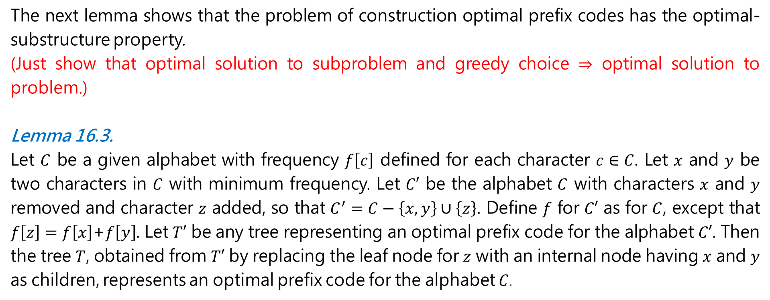
Correction of Huffman’s algorithm
The next lemma shows that the problem of construction optimal prefix codes has the optimal-substructure property.
(Just show that optimal solution to subproblem and greedy choice $⇒$ optimal solution to problem.)
Lemma 16.3.
Let $C$ be a given alphabet with frequency $f\left[c\right]$ defined for each character $c∈C$. Let $x$ and $y$ be two characters in $C$ with minimum frequency. Let $C′$ be the alphabet $C$ with characters $x$ and $y$ removed and character $z$ added, so that $C^{′}=C−\left\{x, y\right\}∪\left\{z\right\}$. Define $f$ for $C′$ as for $C$, except that $f\left[z\right]=f\left[x\right]$+$f\left[y\right]$. Let $T′$ be any tree representing an optimal prefix code for the alphabet $C′$. Then the tree $T$, obtained from $T′$ by replacing the leaf node for $z$ with an internal node having $x$ and $y$ as children, represents an optimal prefix code for the alphabet $C$.

Slide 35
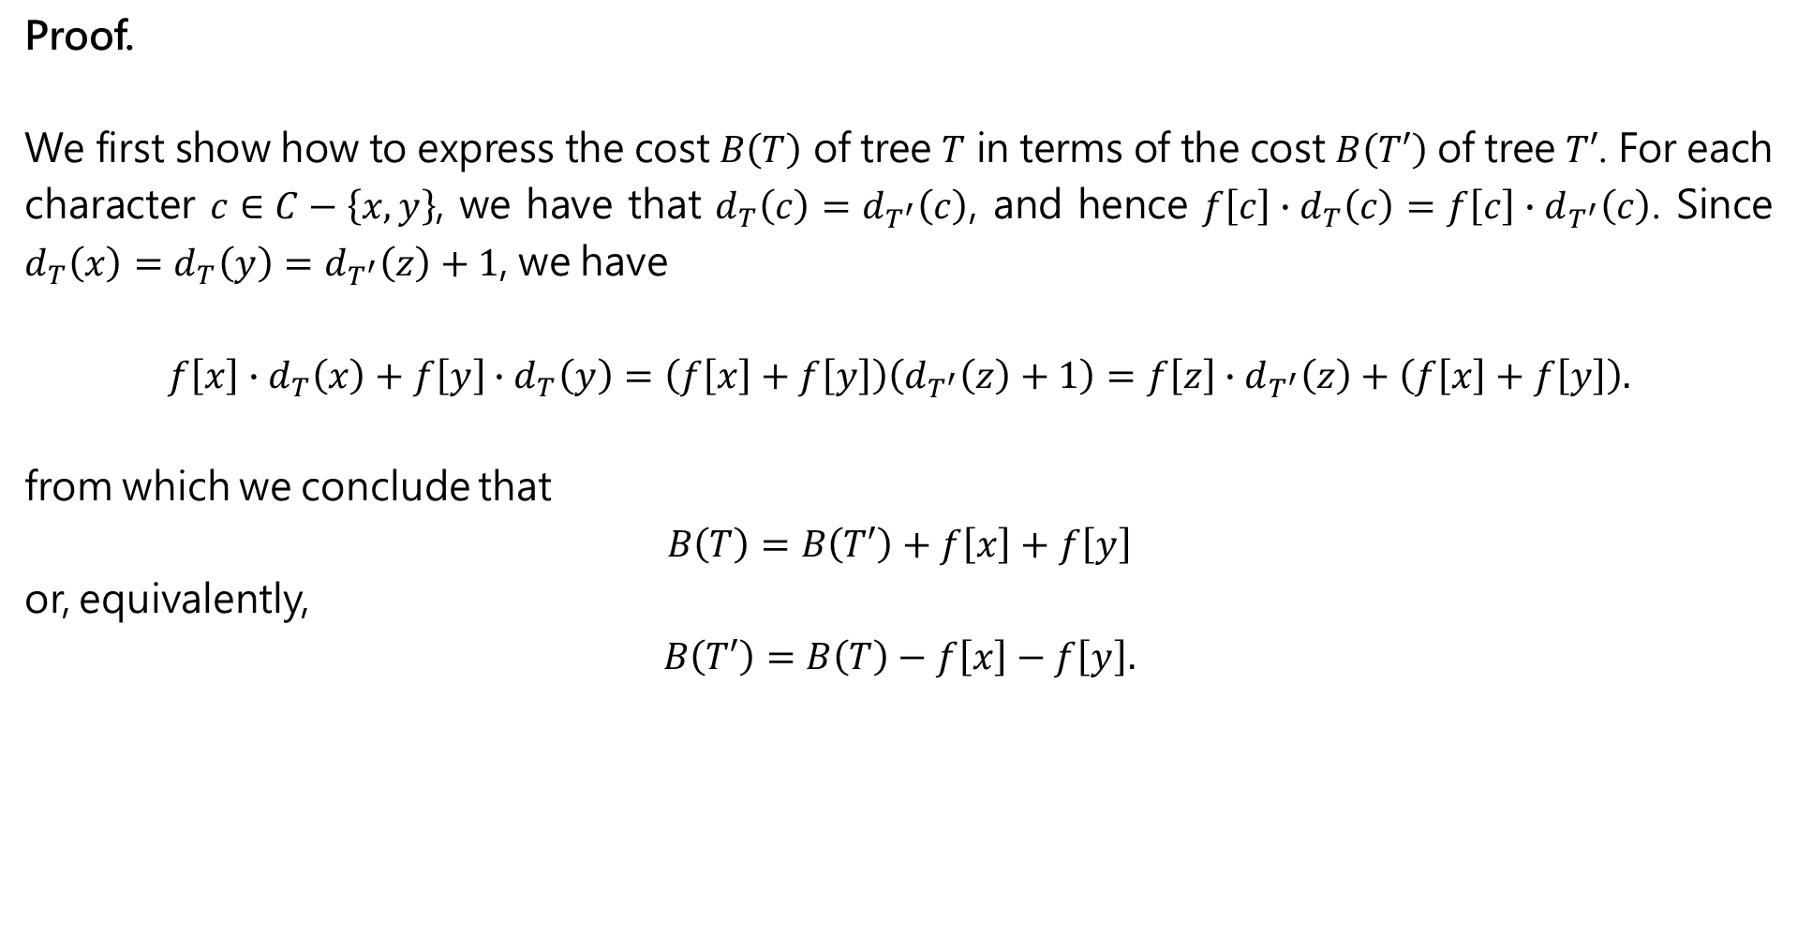
Proof.
We first show how to express the cost $B\left(T\right)$ of tree $T$ in terms of the cost $B\left(T′\right)$ of tree $T′$. For each character $c∈C−\left\{x, y\right\}$, we have that $d_{T}\left(c\right)=d_{T^{′}}\left(c\right)$, and hence $f\left[c\right]∙d_{T}\left(c\right)=f\left[c\right]∙d_{T^{′}}\left(c\right)$. Since $d_{T}\left(x\right)=d_{T}\left(y\right)=d_{T^{′}}\left(z\right)+1$, we have
$$f\left[x\right]∙d_{T}\left(x\right)+f\left[y\right]∙d_{T}\left(y\right)=\left(f\left[x\right]+f\left[y\right]\right)\left(d_{T^{′}}\left(z\right)+1\right)=f\left[z\right]∙d_{T^{′}}\left(z\right)+\left(f\left[x\right]+f\left[y\right]\right).$$
from which we conclude that
$$B\left(T\right)=B\left(T′\right)+f\left[x\right]+f\left[y\right]$$
or, equivalently,
$$B\left(T′\right)=B\left(T\right)−f\left[x\right]−f\left[y\right].$$

Slide 36

$$B\left(T\right)=\sum_{c∈C}{f\left[c\right]∙d_{T}\left(c\right)}=\sum_{c∈C−\left\{x, y\right\}}{f\left[c\right]∙d_{T}\left(c\right)}+f\left[x\right]∙d_{T}\left(x\right)+f\left[y\right]∙d_{T}\left(y\right)$$
$$=\sum_{c∈C−\left\{x, y\right\}}{f\left[c\right]∙d_{T}\left(c\right)}+f\left[z\right]∙d_{T^{′}}\left(z\right)+\left(f\left[x\right]+f\left[y\right]\right)$$
$$=\sum_{c∈C−\left\{x, y\right\}}{f\left[c\right]∙d_{T^{′}}\left(c\right)}+f\left[z\right]∙d_{T^{′}}\left(z\right)+\left(f\left[x\right]+f\left[y\right]\right)$$
$$=\sum_{c∈C^{′}}{f\left[c\right]∙d_{T^{′}}\left(c\right)}+f\left[x\right]+f\left[y\right]$$
$$=B\left(T′\right)+f\left[x\right]+f\left[y\right]$$

Slide 37
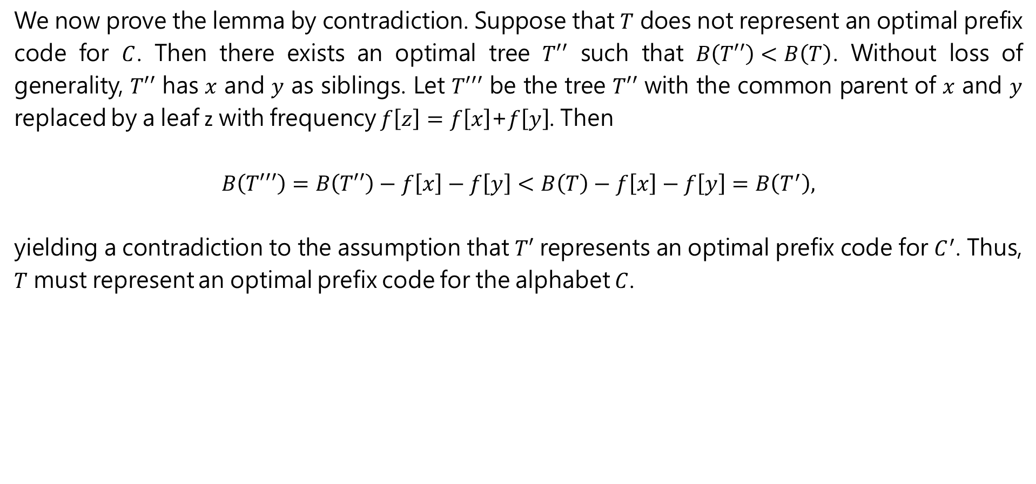
We now prove the lemma by contradiction. Suppose that $T$ does not represent an optimal prefix code for $C$. Then there exists an optimal tree $T′′$ such that $B\left(T′′\right)<B\left(T\right)$. Without loss of generality, $T′′$ has $x$ and $y$ as siblings. Let $T′′′$ be the tree $T′′$ with the common parent of $x$ and $y$ replaced by a leaf z with frequency $f\left[z\right]=f\left[x\right]$+$f\left[y\right]$. Then
$$B\left(T′′′\right)=B\left(T′′\right)−f\left[x\right]−f\left[y\right]<B\left(T\right)−f\left[x\right]−f\left[y\right]=B\left(T^{′}\right),$$
yielding a contradiction to the assumption that $T′$ represents an optimal prefix code for $C^{′}$. Thus, $T$ must represent an optimal prefix code for the alphabet $C$.

Slide 38
Theorem 16.4
Theorem 16.4.
Procedure HUFFMAN produces an optimal prefix code.

